Slide 1
Chapter 1 – Architectural Design
Software Architecture and Design
Mutah University
Faculty of IT
Department of Software Engineering
Dr. Ra’Fat A. AL-Msie’Deen
rafatalmsiedeen@mutah.edu.jo
https://rafat66.github.io/Al-Msie-Deen/

Slide 2
Reference - Text Book:
Chapter 6 of Software Engineering book - by Ian Sommerville. l0th Edition. Addison Wesley, 2015, ISBN-10: 0137035152.

Slide 3
Topics covered
Architectural design decisions
Architectural views
Architectural patterns
Application architectures

Slide 4
Application architectures Transaction processing systems Information systems

Slide 5
Information systems
All systems that involve interaction with a shared database can be considered to be transaction-based information systems.
An information system allows controlled access to a large base of information, such as a library catalog, a flight timetable, or the records of patients in a hospital.
Information systems are almost always web-based systems, where the user interface is implemented in a web browser.

Slide 6
Information systems … cont.
Figure 1 presents a very general model of an information system.
The system is modeled using a layered approach (discussed in Section 6.3) where the top layer supports the user interface and the bottom layer is the system database.
The user communications layer handles all input and output from the user interface, and the information retrieval layer includes application-specific logic for accessing and updating the database.
The layers in this model can map directly onto servers in a distributed Internet-based system.

Slide 7
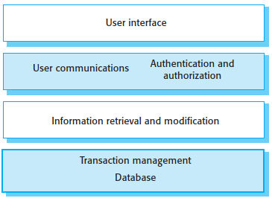
Layered information system architecture
Figure 1. Layered information system architecture.

Slide 8
Information systems architecture
Information systems have a generic architecture that can be organized as a layered architecture.
These are transaction-based systems as interaction with these systems generally involves database transactions.
Layers include:
The user interface
User communications
Information retrieval
System database

Slide 9
The architecture of the Mentcare system
As an example of an instantiation of this layered model, Figure 2 shows the architecture of the Mentcare system.
Recall that this system maintains and manages details of patients who are consulting specialist doctors about mental health problems.
I have added detail to each layer in the model by identifying the components that support user communications and information retrieval and access.

Slide 10
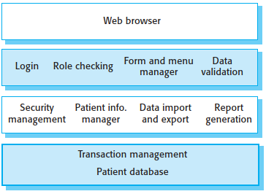
The architecture of the Mentcare system … cont.
Figure 2. The architecture of the Mentcare system.

Slide 11
The architecture of the Mentcare system … cont.
The top layer is a browser-based user interface.
The second layer provides the user interface functionality that is delivered through the web browser. It includes components to allow users to log in to the system and checking components that ensure that the operations they use are allowed by their role. This layer includes form and menu management components that present information to users, and data validation components that check information consistency.

Slide 12
The architecture of the Mentcare system … cont.
The third layer implements the functionality of the system and provides components that implement system security, patient information creation and updating, import and export of patient data from other databases, and report generators that create management reports.
Finally, the lowest layer, which is built using a commercial database management system, provides transaction management and persistent data storage.

Slide 13
Web-based information systems
Information and resource management systems are sometimes also transaction processing systems.
For example, e-commerce systems are Internet-based resource management systems that accept electronic orders for goods or services and then arrange delivery of these goods or services to the customer.
In an e-commerce system, the application-specific layer includes additional functionality supporting a “shopping cart” in which users can place a number of items in separate transactions, then pay for them all together in a single transaction.

Slide 14
Web-based information systems … cont.
The organization of servers in these systems usually reflects the four-layer generic model presented in Figure 1.
These systems are often implemented as distributed systems with a multitier client server/architecture.

Slide 15
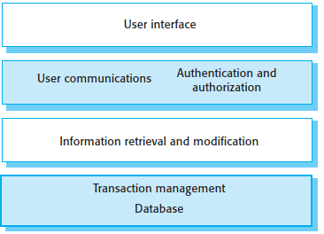
Layered information system architecture
Figure 1. Layered information system architecture.

Slide 16
Web-based information systems … cont.
The web server is responsible for all user communications, with the user interface implemented using a web browser;
The application server is responsible for implementing application-specific logic as well as information storage and retrieval requests;
The database server moves information to and from the database and handles transaction management.

Slide 17
Web-based information systems … cont.
Information and resource management systems are now usually web-based systems where the user interfaces are implemented using a web browser.
For example, e-commerce systems are Internet-based resource management systems that accept electronic orders for goods or services and then arrange delivery of these goods or services to the customer.
In an e-commerce system, the application-specific layer includes additional functionality supporting a ‘shopping cart’ in which users can place a number of items in separate transactions, then pay for them all together in a single transaction.

Slide 18
Server implementation
These systems are often implemented as multi-tier client server/architectures.
The web server is responsible for all user communications, with the user interface implemented using a web browser;
The application server is responsible for implementing application-specific logic as well as information storage and retrieval requests;
The database server moves information to and from the database and handles transaction management.

Slide 19
Server implementation … cont.
Using multiple servers allows high throughput and makes it possible to handle thousands of transactions per minute.
As demand increases, servers can be added at each level to cope with the extra processing involved.

Slide 20
Key points
Models of application systems architectures help us understand and compare applications, validate application system designs and assess large-scale components for reuse.
All systems that involve interaction with a shared database can be considered to be transaction-based information systems.
An information system allows controlled access to a large base of information, such as a library catalog.
Information systems are almost always web-based systems, where the user interface is implemented in a web browser.

Slide 21
Chapter 1 – Architectural Design
Software Architecture and Design
Mutah University
Faculty of IT
Department of Software Engineering
Dr. Ra’Fat A. AL-Msie’Deen
rafatalmsiedeen@mutah.edu.jo
https://rafat66.github.io/Al-Msie-Deen/

